Slide 1
Announcements
No surprise quiz this Friday
Tutorial on schedule

Slide 2


ESC101: Introduction to Computing
Strings

Slide 3
Recap about arrays
Basics: Arrays are
defined as follows.
float w[100];
int num[10];
char s[10];
….
w
array of floats
w[0]
w[1]
w[2]
w[99]
float w[100] defines 100 variables of type float. Their names are indexed: w[0],w[2],…w[99]
array of ints
num
num[0]
num[1]
num[2]
num[9]
array of characters
It also defines a variable called w which stores the address of w[0].
s
s[0] s[1] s[2]
s[9]

Slide 4
How can we create an int array num[] and initialize it to:
num
-2
3
5
-7
19
103
11
Method 1
int num[] = {-2,3,5,-7,19, 103, 11};
Initial values are placed within curly braces separated by commas.
The size of the array need not be specified. It is set to the number of initial values provided.
Array elements are assigned in sequence in the index order. First constant is assigned to array element [0], second constant to [1], etc..
Method 2
int num[10] = {-2,3,5, -7, 19, 103, 11};
Specify the array size. size must be at least equal to the number of initialized values. Array elements assigned in index order. Remaining elements are set to 0.

Slide 5
Recommended method: array size determined from the number of initialization values.
int num[] = {-2,3,5,-7,19,103,11};
Is this correct?
int num[100] ={0,-1,1,-1};
YES! Creates num as an array of size 100. First 4 entries are initialized as given. num[4] … num[99] are set to 0.
num
0
-1
1
-1
0
0
0
Is this correct?
NO! it won’t compile!
int num[6] = {-2,3,5,-7,19,103,11};
num is declared to be an int array of size 6 but 7 values have been initialized.
Number of initial values must be less than equal to the size specified.
Why?

Slide 6


Initialization values could be constants or constant expressions. Constant expressions are expressions built out of constants.
int num[] = { 109, 7+3, 25*1023 };
Type of each initialization constant should be promotable/demote-able to array element type.
E.g.,
int num[] = { 1.09, ‘A’, 25.05};
Float constants 1.09 and 25.05 downgraded to int
Would
this work?
int curr = 5;
int num[] = { 2, curr*curr+5};
YES! ANSI C allows constant expressions AND
simple expressions for initialization values. “Simple” is compiler dependent.

Slide 7
Character array initialization
Character arrays may be initialized like arrays of any other type. Suppose we want the following char array.
‘I’
‘ ’
‘a’
‘m’
‘ ‘
‘D’
‘I’
s
‘O’
‘N’
‘\0’
s[0] s[1] s[2]
s[3] s[4] s[5]
s[6] s[7]
s[8]
We can write:
s[]={‘I’,’ ‘,’a’,’ m’,’ ’,’D’,’O’,’N’,’\0’ };
BUT! C allows us to define string constants. We can also write:
s[] = “I am DON”;
“I am DON” is a string constant. Strings constants in C are specified by enclosing in double quotes.
It is equivalent to a character array ending with ‘\0’.
The ‘\0’ character (also called NULL char) is automatically added to the end.

Slide 8
Printing strings
We have used string constants many times. Can you recall?
printf and scanf: the first argument is always a string.
printf(“The value is %d\n”, value);
scanf(“%d”, &value);
Strings are printed using %s option.
Output
E.g. 1
printf(“%s”, “I am DON”);
I am DON
Output
E.g. 2
char str[]=“I am GR8DON”;
printf(“%s”, str);
I am GR8DON
‘I’
‘ ’
‘a’
‘m’
‘ ’
‘G’
‘R’
‘8’
‘D’
‘O’
‘N’
‘\0’
str
str[0]
str[2]
str[4]
str[6]
str[8]
str[11]
State of memory after definition of str in E.g. 2. Note the NULL char added in the end.
This NULL char is not printed.

Slide 9
Strings
Consider the fragment.
This defines a constant string, i.e., character array terminated by, but not including, ‘\0’.
char str[]=“I am GR8DON”;
str[4] = ‘\0’;
printf(“%s”, str);
What is printed?
Let us trace the memory state of str[].
str
str[0]
str[2]
str[4]
str[6]
str[8]
str[11]
‘I’
‘ ’
‘a’
‘m’
‘ ’
‘G’
‘R’
‘8’
‘D’
‘O’
‘N’
‘\0’
‘\0’
Output
A string is a sequence of characters terminated by ‘\0’. This ‘\0’ is not part of the string.
I am
There may be non-null characters after the first occurrence of ‘\0’ in str[]. They are not part of the string str[] and don’t get printed by printf(“%s”, str);

Slide 10


So did we lose the chars after the first ‘\0’ ? Where did they go?
Of course not, they remain right where they were. They were not printed because we used %s in printf. Let’s take a look.
str
str[0]
str[2]
str[4]
str[6]
str[8]
str[11]
‘I’
‘ ’
‘a’
‘m’
‘ \0’
‘G’
‘R’
‘8’
‘D’
‘O’
‘N’
‘\0’
char str[]=“I am GR8DON”;
str[4]=‘\0’;
printf(“%s”, str);
Output
The character
‘\0’ may be printed differently on screen depending on terminal settings.
I am
int i;
for (i=0; i < 11; i++) {
putchar(str[i]);
}
Output
I amGR8DON

Slide 11
Reading a String (scanf)
Placeholder: %s
Argument: Name of character array.
No & sign before character array name. (?)
Input taken in a manner similar to numeric input.
With %s, scanf skips whitespaces.
There are three basic whitespace characters in C : space, newline ('\n') and tab ('\t').
Any combination of the three basic whitespace characters is a whitespace.

Slide 12
Reading a String (scanf)
Starts with the first non-whitespace character.
Copies the characters into successive memory cells of the character array variable.
When a whitespace character is reached, scanning stops.
scanf places the null character at the end of the string in the array variable.

Slide 13
#include <stdio.h>
int main() {
char str1[20], str2[20];
scanf("%s",str1);
scanf("%s",str2);
printf("%s + %s\n",
str1, str2);
return 0;
}
INPUT
IIT Kanpur
OUTPUT
IIT + Kanpur
INPUT
I am DON
OUTPUT
I + am

Slide 14
Why is there no & when we read character array?
Remember parameter passing?
A simple variable can not be modified from inside a function call (Recall swap() function)
However, Arrays can be modified from inside a function call (Recall read_into_array() function)
Similarly, scanf can also “modify” arrays directly. Since string is just an array of chars, & is not required.
More on this when we do pointers

Slide 15
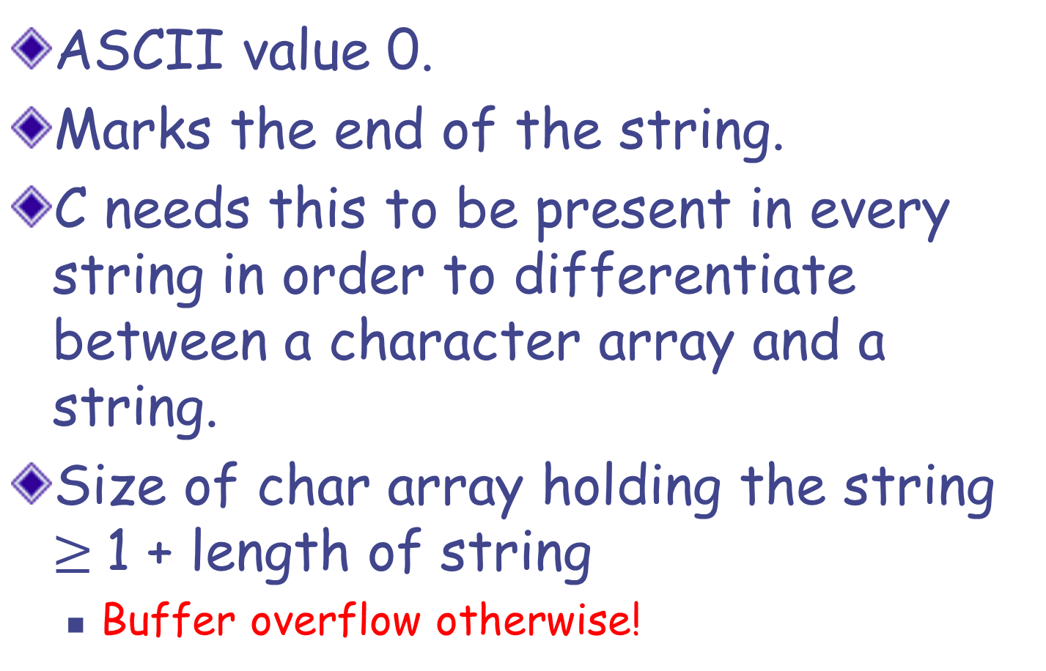
NULL character ‘\0’
ASCII value 0.
Marks the end of the string.
C needs this to be present in every string in order to differentiate between a character array and a string.
Size of char array holding the string $≥$1 + length of string
Buffer overflow otherwise!

Slide 16
NULL character ‘\0’
What happens if no '\0' is kept at the end of string?
‘\0’ is used to detect end of string, for example in printf(“%s”, str).
Without ‘\0’, such functions will keep reading array elements beyond the array bound (out of bound access).
We can get an incorrect result or a Runtime Error.

Slide 17
Reading a line as an input
scanf, when used with the %s placeholder, reads a block of non-whitespace characters as a string.
What if we want to read a line as a string?
We will define our own function to read a line.
EXERCISE: Take as input a line (that ends with the newline character) into a character array as a string.

Slide 18

#include <stdio.h>
// read a line into str, return length
int read_line(char str[]) {
int c, i=0;
c = getchar();
while (c != ‘\n’ && c != EOF) {
str[i] = c;
c = getchar();
i++;
}
str[i] = ‘\0’; // we want a string!
return i; // i is the length of the string
}
Buffer overflow possible

Slide 19
#include <stdio.h>
// read a line into str, return length.
// maximum allowed length is limit
int read_line(char str[] ) {
int c, i=0;
c = getchar();
while (c != ‘\n’ && c != EOF) {
str[i] = c;
c = getchar();
i++;
if (i == limit-1) break;
}
str[i] = ‘\0’; // we want a string!
return i; // i is the length of the string
}
, int limit
Safer version!

Slide 20
Copying one String to Other
We can not copy content of one string variable to other using assignment operator
This is true for any array variable.
We need to do element-wise copying
char str1[] = "Hello";
char str2[] = str1;
WRONG

Slide 21
String Copy
str_copy(char dest[], char src[]);
Arguments: Two strings: dest and src.
Copy contents of src into dest.
We assume that dest is declared with size at least as large as src.
Note the use of ‘\0’ for loop termination
void str_copy(char dest[], char src[]) {
int i;
for (i = 0; src[i] != '\0’; i++)
{ dest[i] = src[i]; }
dest[i] = '\0';
}

Slide 22
Comparing Two Strings
Lexicographical Ordering
A string str1 is said to be lexicographically smaller than another string str2 if the first character, where the strings differ, is smaller in str1.
Examples:
"cap" is smaller than "cat".
"mat" is smaller than "matter".
Order of words in a Dictionary

Slide 23
String Comparison
We will write a function that compares two strings lexicographically:
str_compare (char str1[], char str2[])
Arguments: Two strings str1 and str2
Return value:
0 if the strings are equal,
-1 if str1 is "smaller",
1 if str2 is "smaller".
Assumption: The strings contain letters of one case (either capital or small).

Slide 24
Code for str_compare
int str_compare(char str1[], char str2[]){
int i=0;
while (str1[i]==str2[i]){//skip over same chars
if (str1[i]=='\0')
break;
i++;
}
if (str1[i] == str2[i])
return 0;
else if (str1[i] < str2[i])
return -1;
else
return 1;
}
When can this happen?
//str2 < str1
At this point, since the first differing characters are such that str1[i] < str2[i], => str1 is smaller

Slide 25
Other string functions
Return length of a string.
Concatenates one string with another.
Search for a substring in a given string.
Reverse a string
Find first/last/k-th occurrence of a character in a string
… and more
Case sensitive/insensitive versions

Slide 26
string.h
Header File with Functions on Strings
strlen(s): returns length of string s (without ‘\0’)
strcpy(d, s): copies s into d
strcmp(s1, s2): return an integer less than, equal to, or greater than zero if s1 is found, respectively, to be less than, to match, or be greater than s2.
strcat(d, s): appends s at the end of d (‘\0’ is moved to the end of result)

Slide 27
string.h
strncpy(d, s, n)
strncmp(s1, s2, n)
strncat(d, s, n)
restrict the function to “n” characters at most (argument n is an integer)
strcasecmp, strncasecmp: case insensitive comparison
Many more utility functions.
All functions depend on ‘\0’ as the end-of-string marker.

